Slide 1
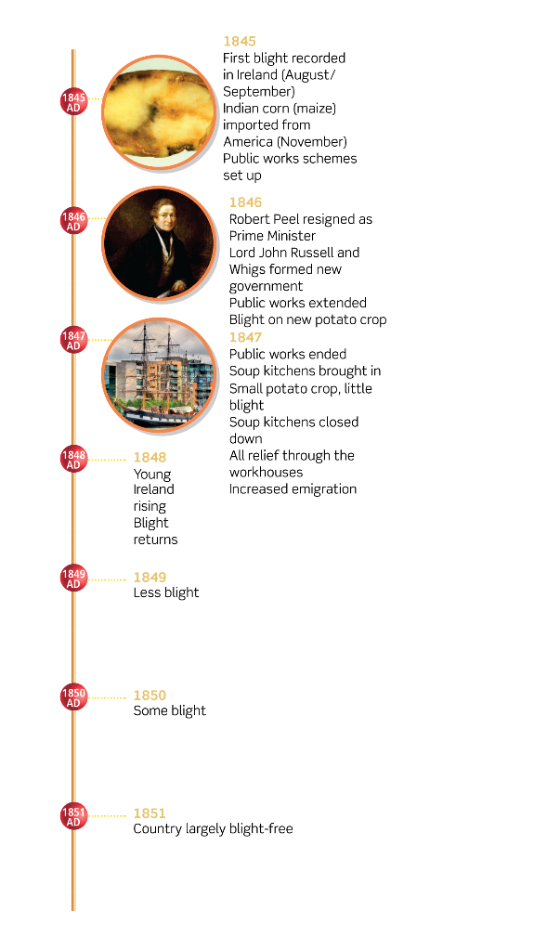
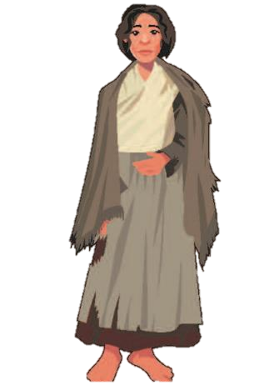
Investigating the Causes, Course and Consequences of the Great Famine
Chapter 12
Notes:
Note to Teachers: Create animations in each slide by clicking on the ‘Animations’ tab on the toolbar and selecting the image/object you would like to animate.

Slide 2
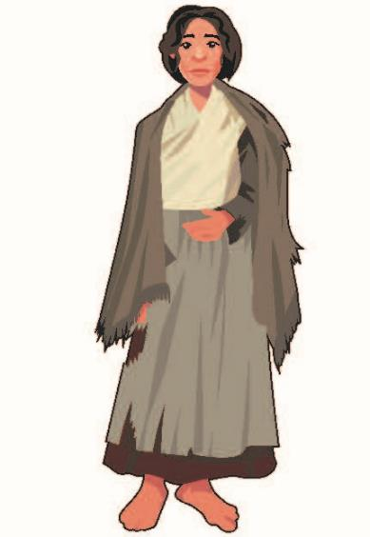
What Will I Learn?
Investigate the causes, course and consequences of the Great Famine
Examine the significance of the Irish Diaspora
Explore the Nature of History

Slide 3
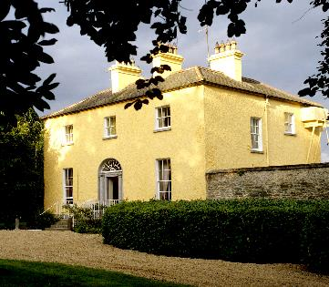
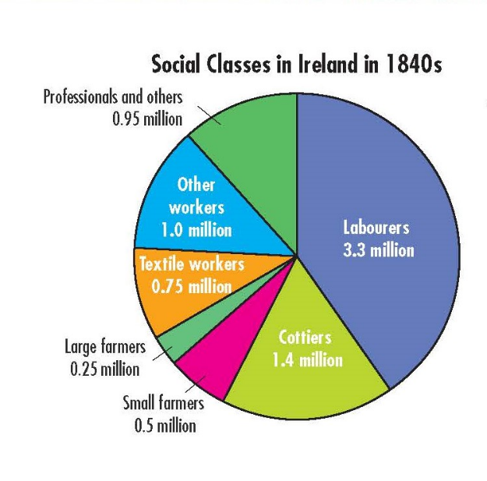
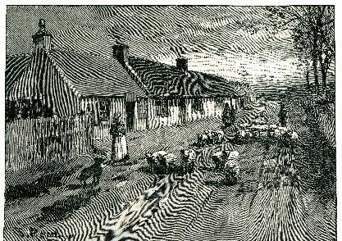
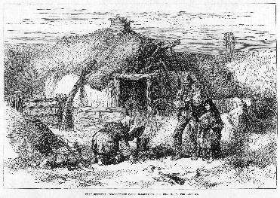
Ireland in 1840
A well-off farmer’s house
Landlords owned most of the land
They rented the land to tenant farmers
A small farmer’s house
Cottiers’ mud cabin

Slide 4
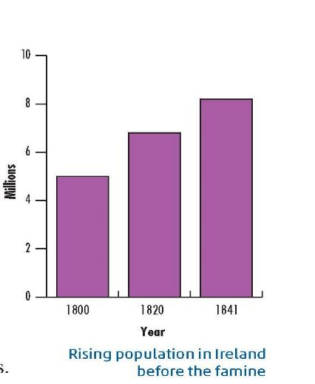
Poverty in the Country
There was much poverty
Rising population
Failed harvests
Dependence on farming
Lack of manufacturing industry
Causes of poverty

Slide 5
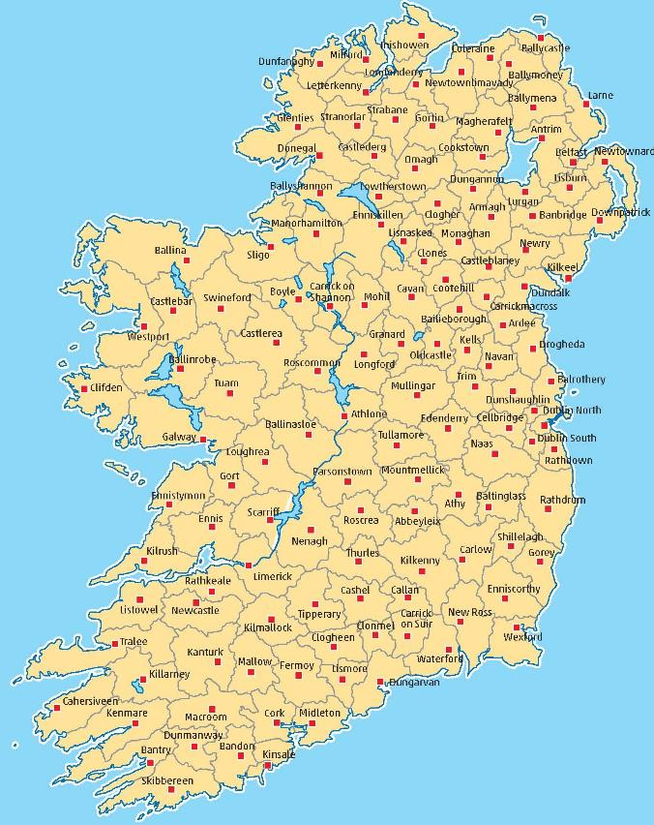
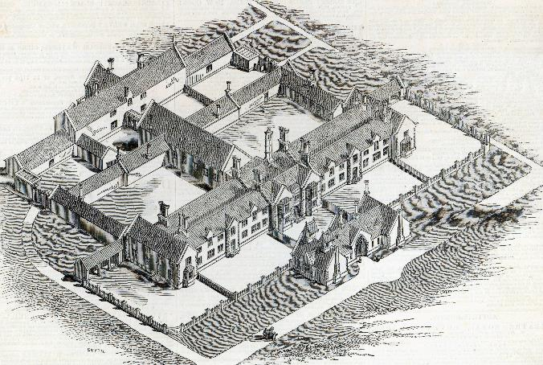
Poverty in the Country
Poor Law Act 1838
Plan of a workhouse
What was a workhouse?
Poor Law Unions and Workhouses

Slide 6
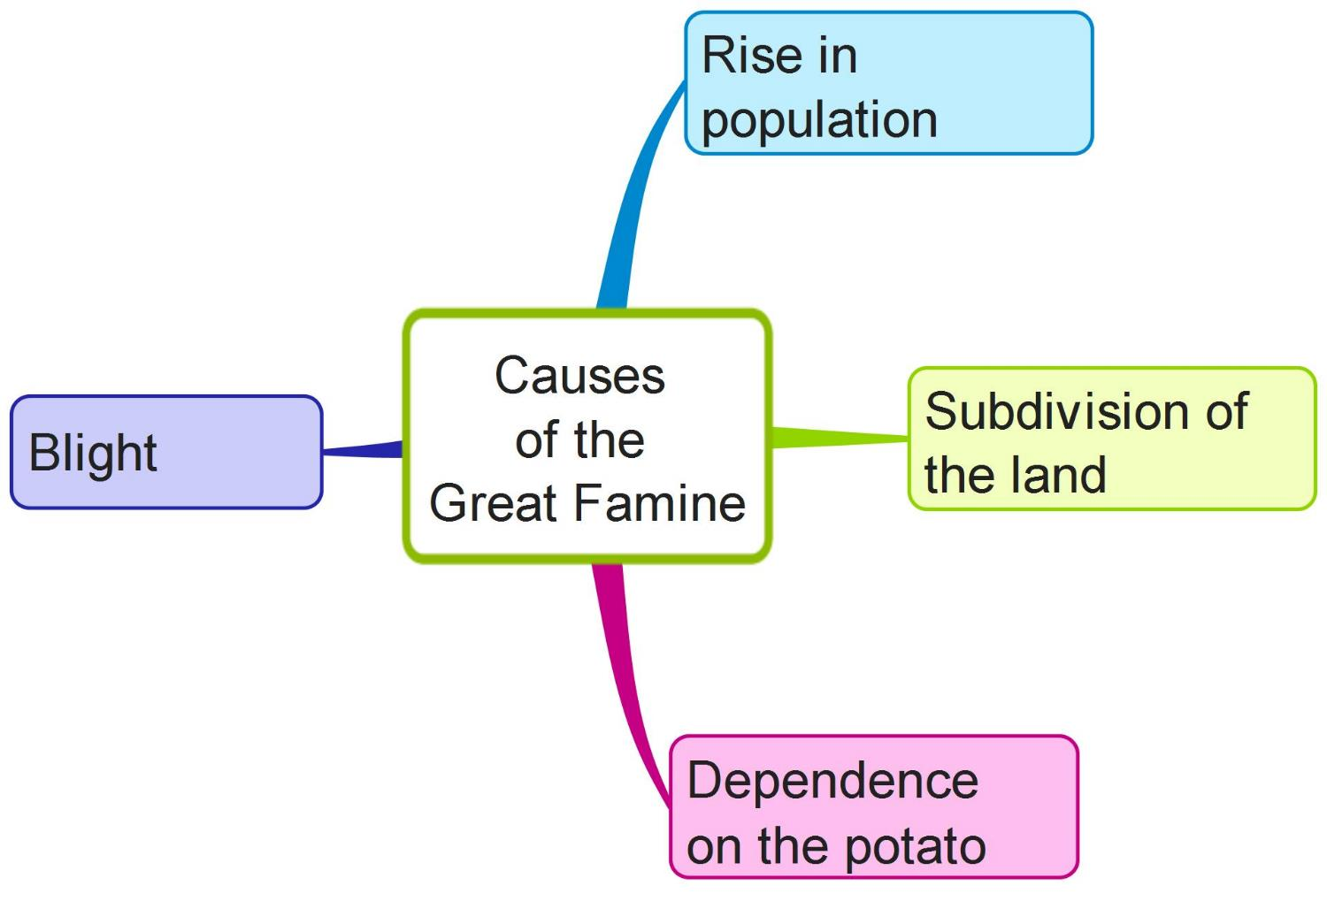
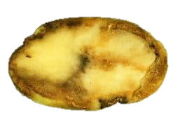

Create your own mind map on the Causes of the Great Famine based on the above features
See Skills Book p. 110

Slide 7
Assessing Your Learning
True or false?
As Ireland’s population grew before the Great Famine,
… the people became poorer. | T/F?
… the poorest people were the big farmers. | T/F?
… Connacht became the most densely populated area. | T/F?
… the farms were subdivided. | T/F?
The Great Famine was caused by …
… the rise in population. | T/F?
… the increased manufacturing in Belfast. | T/F?
… the dependence on the potato. | T/F?
… the coming of blight. | T/F?
… the farmers growing too much wheat. | T/F?

Slide 8
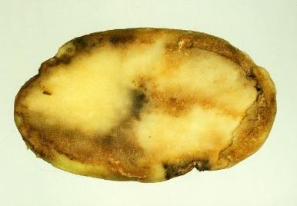
The Progress of the Famine
1845
First blight recorded
1846
Blight everywhere
1847
Little blight but small potato crop
1848
Blight everywhere
1849
Less blight
1850
Some blight
1851
Country largely blight-free

Slide 9

Famine in Skibbereen
Objective?
Source 1
Letter describing a visit to Skibbereen
Being aware that I should have to witness scenes of frightful hunger, I provided myself with as much bread as five men could carry, and on reaching the spot I was surprised to find the wretched hamlet (village near Skibbereen) apparently deserted. I entered some of the hovels to find out the cause, and the scenes that presented themselves were such no tongue or pen can convey the slightest idea of. In the first, six famished and ghastly skeletons, to all appearance dead, were huddled in a corner on some filthy straw, their sole covering what seemed a ragged horse-cloth, naked above the knees. I approached in horror, and found by a low moaning they were alive, they were in fever – four children, a woman, and what had once been a man. It is impossible to go through the details, suffice to say, that in a few minutes I was surrounded by at least 200 of such phantoms (ghosts). By far the greatest number were delirious (feverish), either from famine or fever. Their demonic (crazed) yells are still yelling in my ears, and their horrible images are fixed upon my brain.
(N.M. Cummins, J.P, Cork, 17 December 1846)
Is it fair?
Select fact?
Is it biased?
Select opinion?
Reliable?
Can you trust the source?
Primary or secondary source?
Useful?
Why?
On what does it give information?

Slide 10
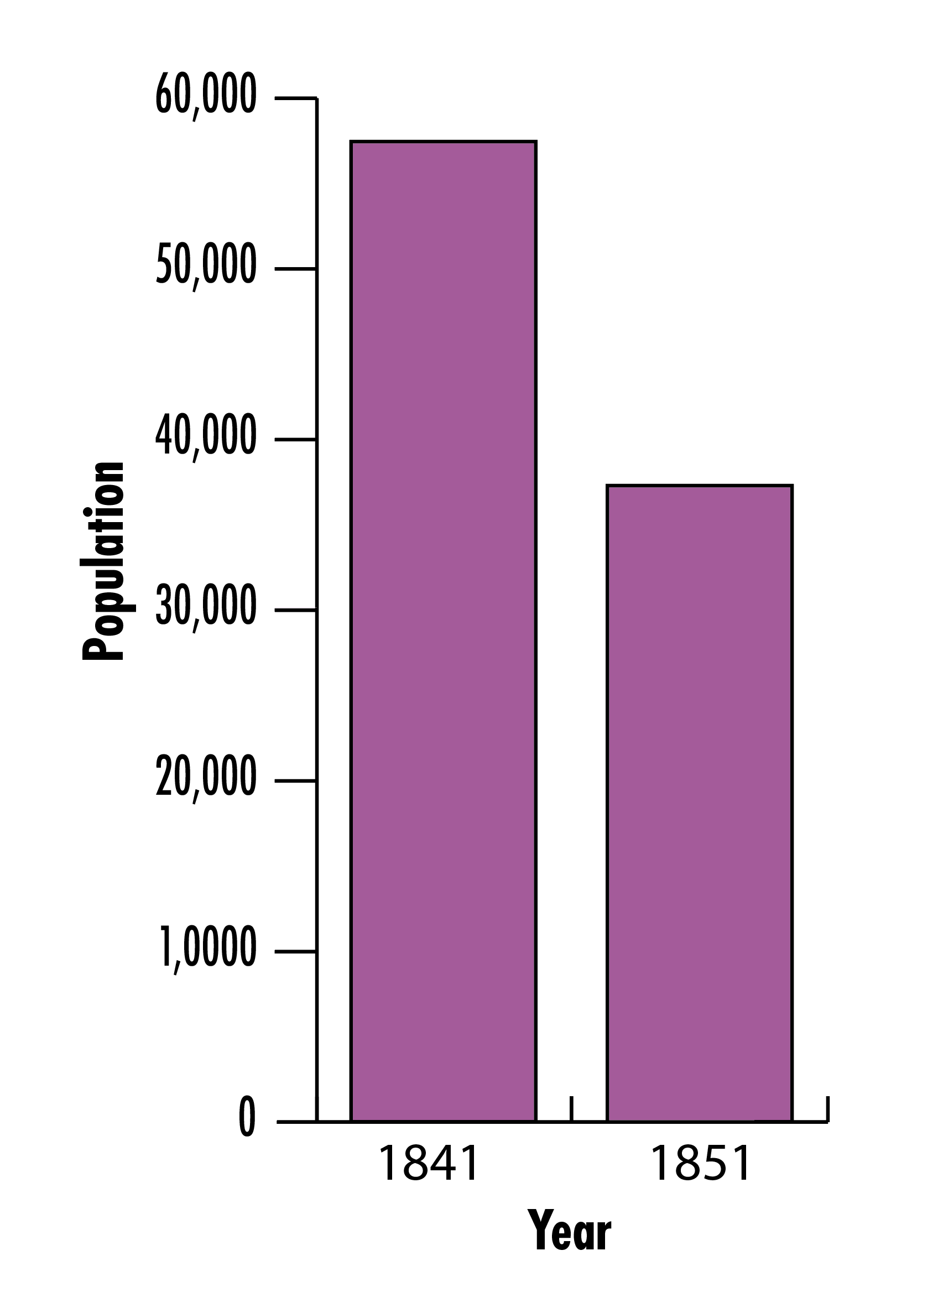
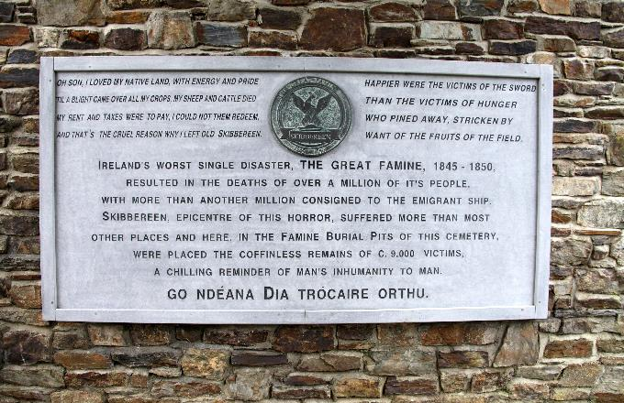
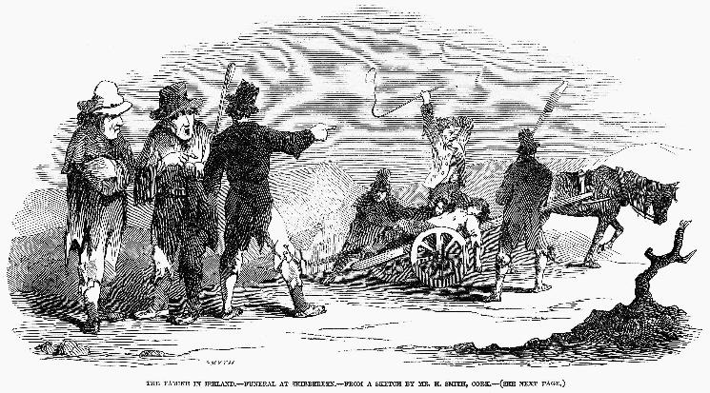
What do these sources tell you about famine in Skibbereen?

Slide 11
Famine in Skibbereen
Source 5
Dear Old Skibbereen (a song probably composed in America about 1880)
My son, I loved our native land with energy and pride
Until a blight fell on my crops, my sheep and cattle died,
The rents and taxes were too high, I could not them redeem,
And that’s the cruel reason why I left old Skibbereen.
----
Oh father dear, the day will come when in answer to the call
Each Irishman with feelings stern will answer one and all,
I’ll be the man to lead the van, beneath our flag of green,
And loud and high we’ll raise the cry, ‘Remember Skibbereen!’
Objective?
Primary or secondary source?
Reliable?
Why?
Useful?

Slide 12
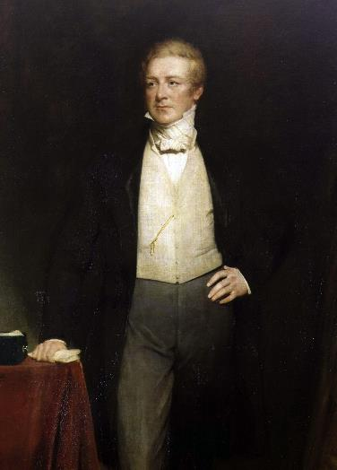
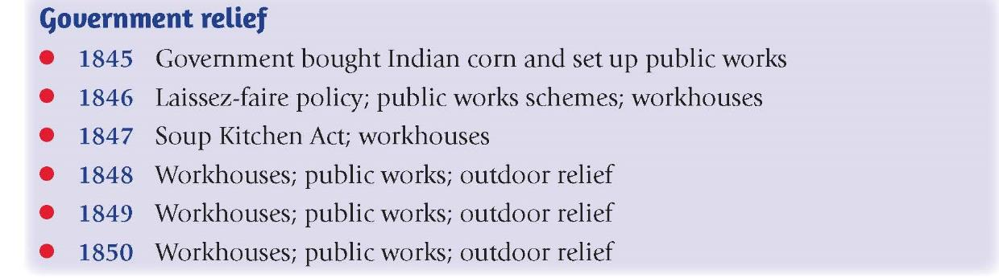

What did the British Government do?
Robert Peel
How successful was each of these policies?
See Skills Book p. 111

Slide 13
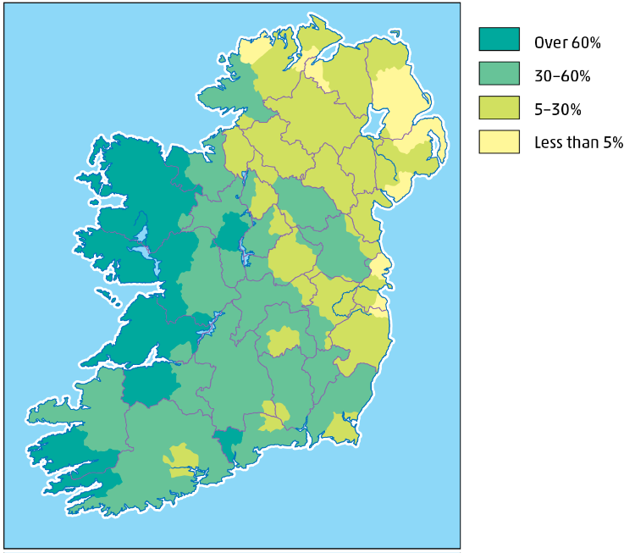
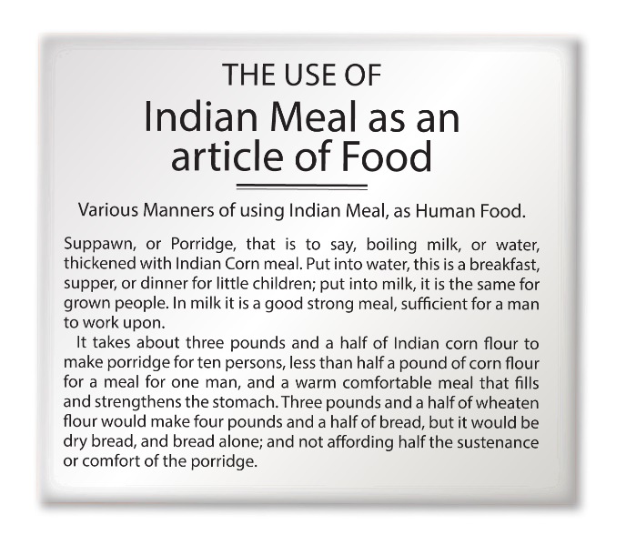
Famine Relief
Map showing the percentage of people taking up rations in the summer of 1847

Slide 14
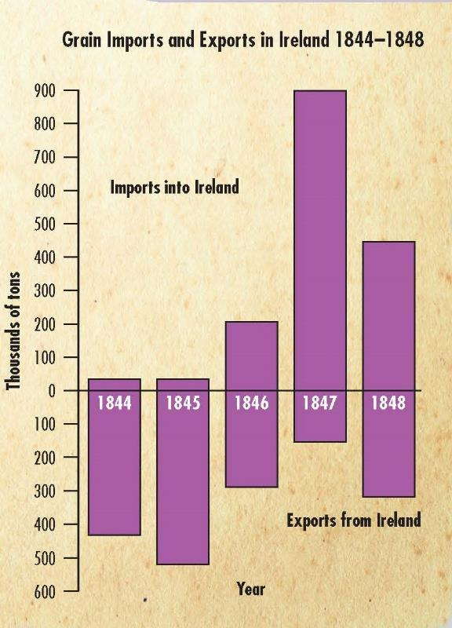
Famine Relief
In what years were exports of grain greater than imports?

Slide 15


Famine Relief
Soup kitchen recipes
Quaker Soup
100 gallons of water 21 lbs each of oatmeal and barley
75 lbs of meat (salt beef or pork) 1 ½ lbs pepper
35 lbs of dried peas 14 lbs of salt
Recipe for Government Soup
21 ½ lbs beef 100 onions
6 ¼ lbs dripping 1 ½ lbs brown sugar
25 lbs each of flour and barley
9 lbs salt
Workhouses
In 1848, 200,000 in workhouses
Overcrowded
Disease spread
‘Outdoor relief’ for 800,000 people
See Skills Book p. 112

Slide 16
Government Policy
Charles Trevelyan was the most senior civil servant who made decisions about famine relief in Ireland
Local distress (suffering) cannot be helped out of national (government) funds without great abuses and evils … All (people) are interested in getting as much as they can. It is nobody’s concern to put a check on the spending. … Ireland is not the only country which would have been thrown off its balance by the attraction of ‘public money’. All classes ‘make a poor mouth,’ as it is called in Ireland. They conceal (hide) their advantages, exaggerate their difficulties, and relax their effort. The cottier does not sow his poor in improving his estate, because by doing so they would disentitle themselves to (forfeit) their ‘share of the relief’.
(Charles Trevelyan, ‘The Irish Crisis’, Edinburgh Review, January 1848)
Do you think Trevelyan favoured helping people with government spending during the Great Famine?
Why is it important to know what Trevelyan’s views were?

Slide 17
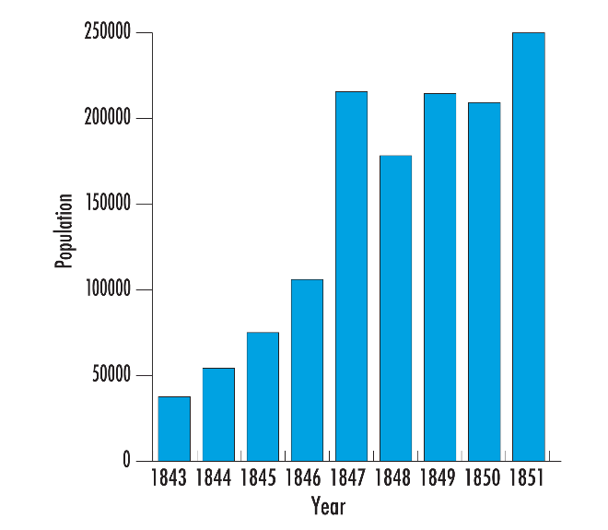
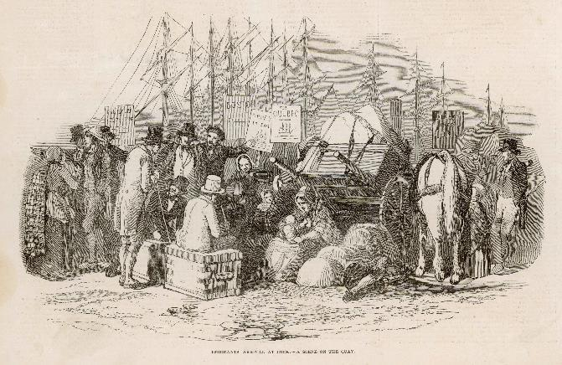

Emigration
Emigration from Ireland, 1843–1851
Emigration from Cork
See Skills Book p. 114

Slide 18
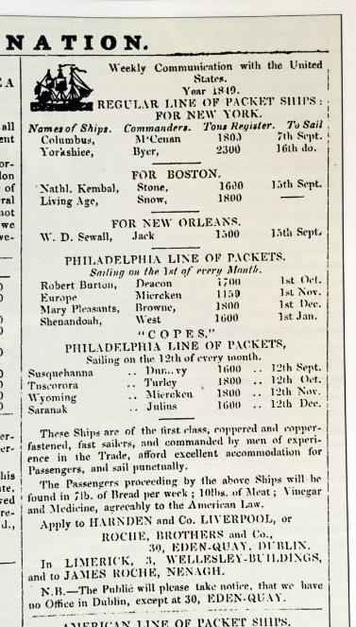
Emigration
Source 3: Advertisement for Packet Ships
Objective?
Primary or secondary source?
Reliable?
Why?
Useful?

Slide 19
Emigration
Source 4
Stephen de Vere who travelled on a ship to Canada
Before the emigrant has been a week at sea he is an altered man. How could it be otherwise? Hundreds of poor people men, women, and children of all ages from the driveling idiot of ninety to the babe just born, huddled together without light, without air, wallowing in filth and breathing a fetid atmosphere, the fever patients lying between the sound. The meat was of the worst quality. The supply of water shipped on board was abundant, but the quantity served out to the passengers was so scanty that they were frequently obliged to throw overboard their salt provisions and rice, because they had not water enough both for the necessary cooking and the satisfying of their raging thirst afterwards. No cleanliness was enforced; the beds never aired; the food contracted for was supplied, though at irregular times; but false measures were used to measure out the food.
What does this source tell you about the voyage to Canada?

Slide 20
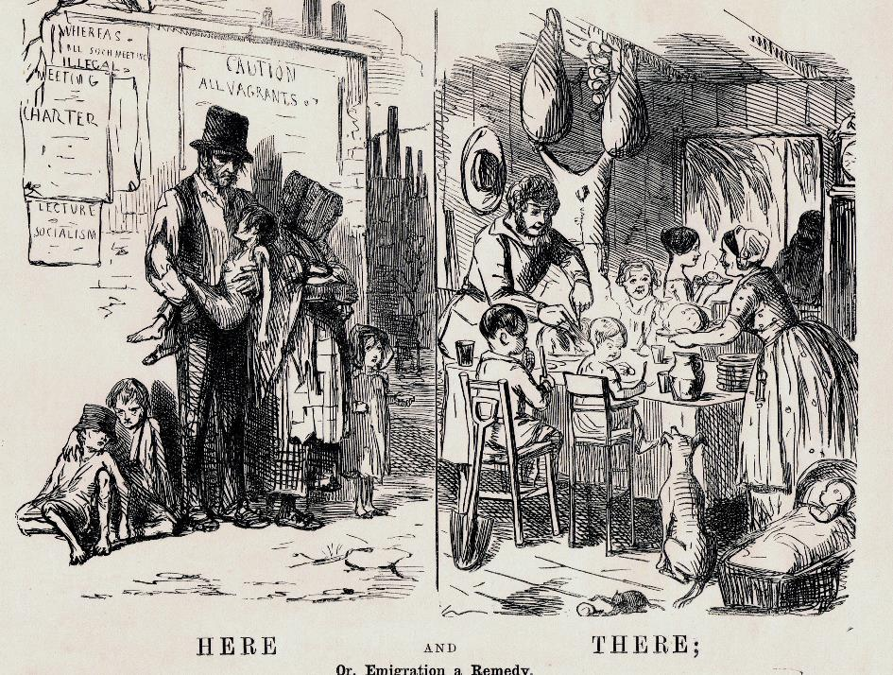
Emigration
Primary or secondary source?
What is the message of this cartoon?
Why?
A cartoon from Punch Magazine, 1848

Slide 21

Emigration
An emigrant’s experience
Isabella McDougall:
Born in 1832, Isabella McDougall was just one of a huge number who left Ireland during the famine years. As a 16-year-old orphan in a workhouse in Banbridge, County Down, Isabella sailed for Australia aboard one of the first of Earl Grey’s orphan ships, a scheme to transport orphaned girls from Irish workhouses to Australia. Many of the Earl Grey orphans became known as ‘workhouse sweep-ins’ by those already there. She landed in Sydney in 1848, and was then transferred to Maitland. She began work as a nursery maid until her marriage to Edward Spicer, an ex-convict, in 1849. Together, they travelled to Armidale, and later Inverell, where Edward worked as a shepherd. They had 13 children before Edward died in 1872, at which point Isabella had to find a way to support herself and her large family. Luckily, she found work as a boarding house mistress in Inverell, until she married for a second time – this time to Angus Mackay, a farmer from Swan Vale. Isabella died in 1904, while on a visit to Glen Innes.
(Source: EPIC, Irish Emigration Museum, Dublin)
What does this account tell you about the emigrants’ experience?

Slide 22
An emigrant’s experience
Thomas Quinn:
As a child, he was one of many to have been affected by the Famine. His family were tenant farmers on the Strokestown Estate in Roscommon, owned by Major Denis Mahon. When Quinn was seven years old, Mahon forced over 3,000 of his starving tenants to emigrate, paying their passage to the cheapest destination – Canada. Travelling in 1847 on the so-called ‘coffin ships’ with no money and barely any clothes, they were easy victims for disease. Quinn’s own parents died of typhus on the journey, just two amongst the 196 other passengers on board who did not survive the journey. The ship was quarantined at Grosse Ille in Quebec, which had become overwhelmed by sick and destitute arrivals from Ireland. Quinn and his brother were fortunate enough to be adopted by a French-Canadian family and both went on to become priests with Thomas Quinn rising to high office. He was adamant to defend his roots through religion, remembering some of his father’s last words: ‘Remember your soul, and your liberty.’
(Source: EPIC, Irish Emigration Museum, Dublin)
What does this account tell you about the emigrants’ experience?

Slide 23
Assessing Your Learning
Complete the following sentences.
1. 1847 and 1848 were … | A. … in a policy of laissez-faire.
2. In 1848, Robert Peel ordered … | B. … Irish property should pay for Irish poverty.
3. The government of Lord John Russell believed … | C. … the Soup Kitchen Act.
4. Laissez-faire was a policy which … | D. … from typhus and cholera.
5. The British government said … | E. … the worst years of the famine.
6. The Quakers introduced … | F. … the importation of Indian Corn.
7. The British government passed … | G. … said the government should not interfere in the economy.
8. The British government closed … | H. … to provide relief (help).
9. Many people died … | I. … their soup kitchens.
10. The workhouses were used … | J. … soup kitchens.

Slide 24
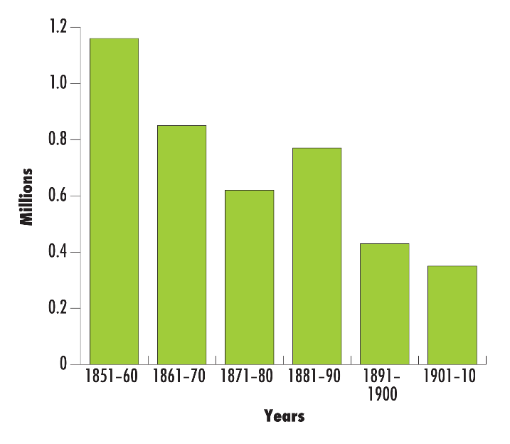
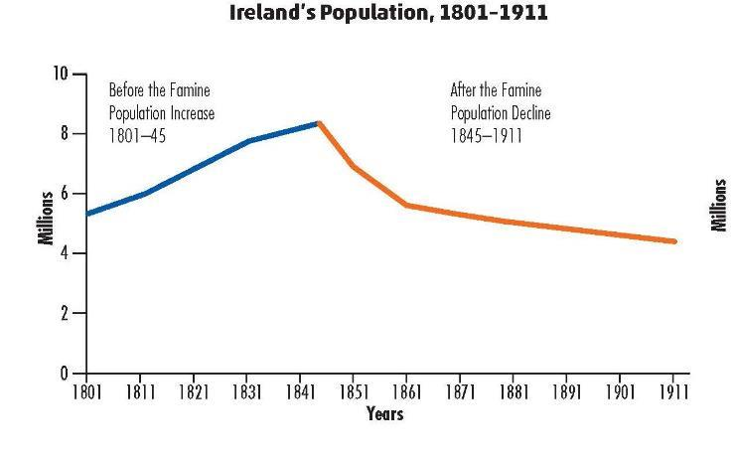

The Consequences of the Famine
Fall in population
Irish emigration, 1851–1910
What accounted for the fall in population?
See Skills Book p. 115

Slide 25

The Consequences of the Famine
Subdivision ended
Eldest son got the land
Eldest son married late
Birth rate reduced
Other sons and daughters forced to emigrate
Population declined
Politics
English government blamed for famine
Emigrants took hatred abroad
Supported later political actions in Ireland
See Skills Book p. 116

Slide 26
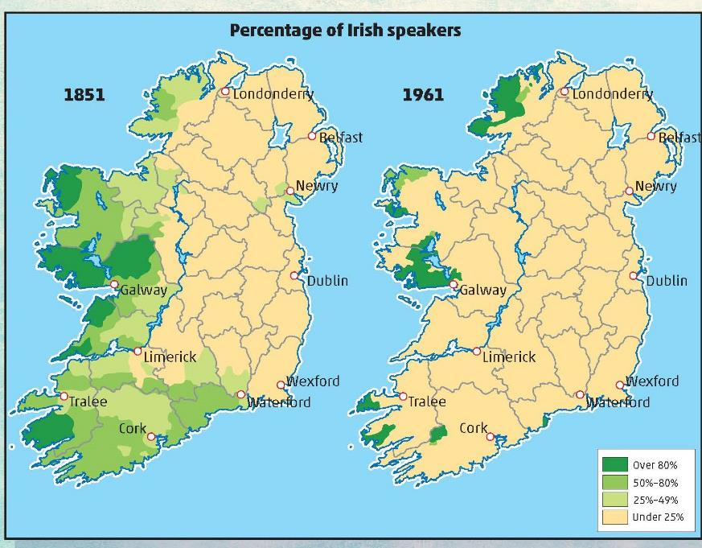
The Consequences of the Famine
Decline in the Irish language
How did the Great Famine contribute to the causes of the decline of the Irish language?
See Skills Book p. 116

Slide 27
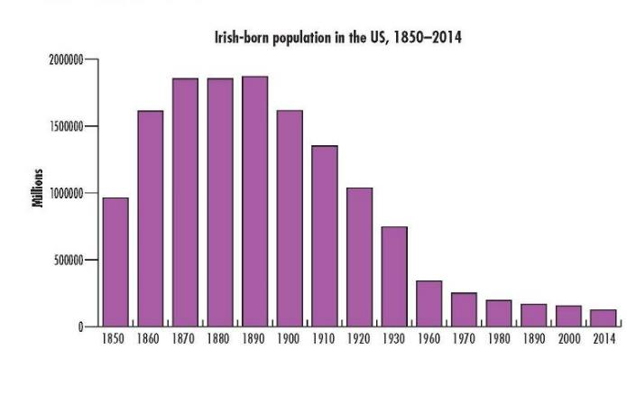
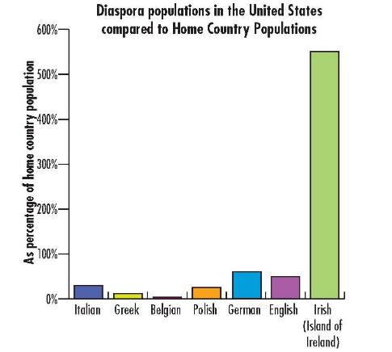
Significance of the Irish Diaspora
What do these graphs tell you about the Irish diaspora in the USA?

Slide 28
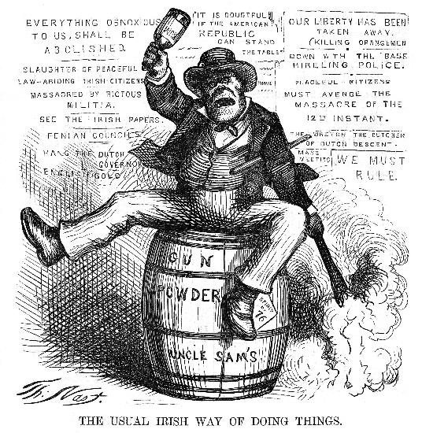
Significance of the Irish Diaspora
Anti-Irish feeling in USA and Britain

Slide 29
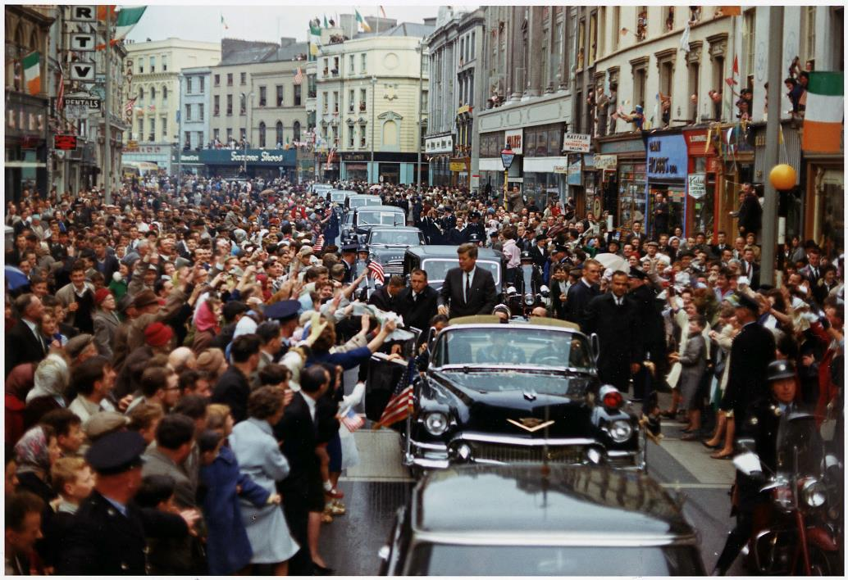
Significance of the Irish Diaspora
‘When my great grandfather left here to become a cooper in East Boston, he carried nothing with him except two things: a strong religious faith and a strong desire for liberty: I am glad to say that all of his great-grandchildren have valued that inheritance.’
(President Kennedy, visiting his ancestral home in Wexford in 1963)

Slide 30

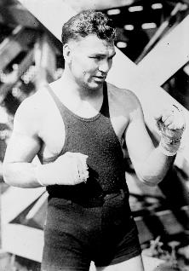
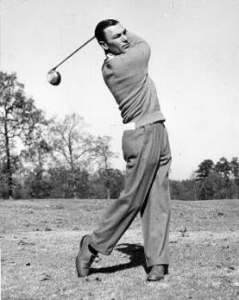


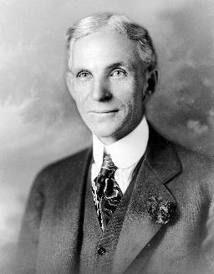

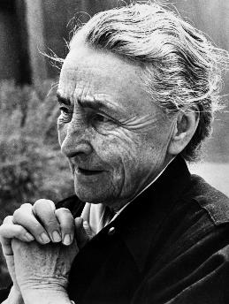

Significance of the Irish Diaspora
Tom Brady
John McEnroe
Jack Dempsey
Ben Hogan
Maureen O’Hara
Investigate well-known people of Irish descent in Britain, Australia and New Zealand
Henry Ford
Muhammad Ali
Georgia O’Keeffe
Anne Rice

Slide 31
Significance of the Irish Diaspora
Population of Irish Diaspora by Country
Country | Population of Irish descent | % of total population
USA | 33,400,000 | 10.5%
UK | 14,000,000 | 10.0%
Australia | 7,000,000 | 30.0%
Canada | 4,600,000 | 14.0%
Argentina | 1,000,000 | 2.5%
New Zealand | 600,000 | 12.6%
South Africa | 330,000 | 1.0%
What do these figures tell you about the Irish diaspora?

Slide 32
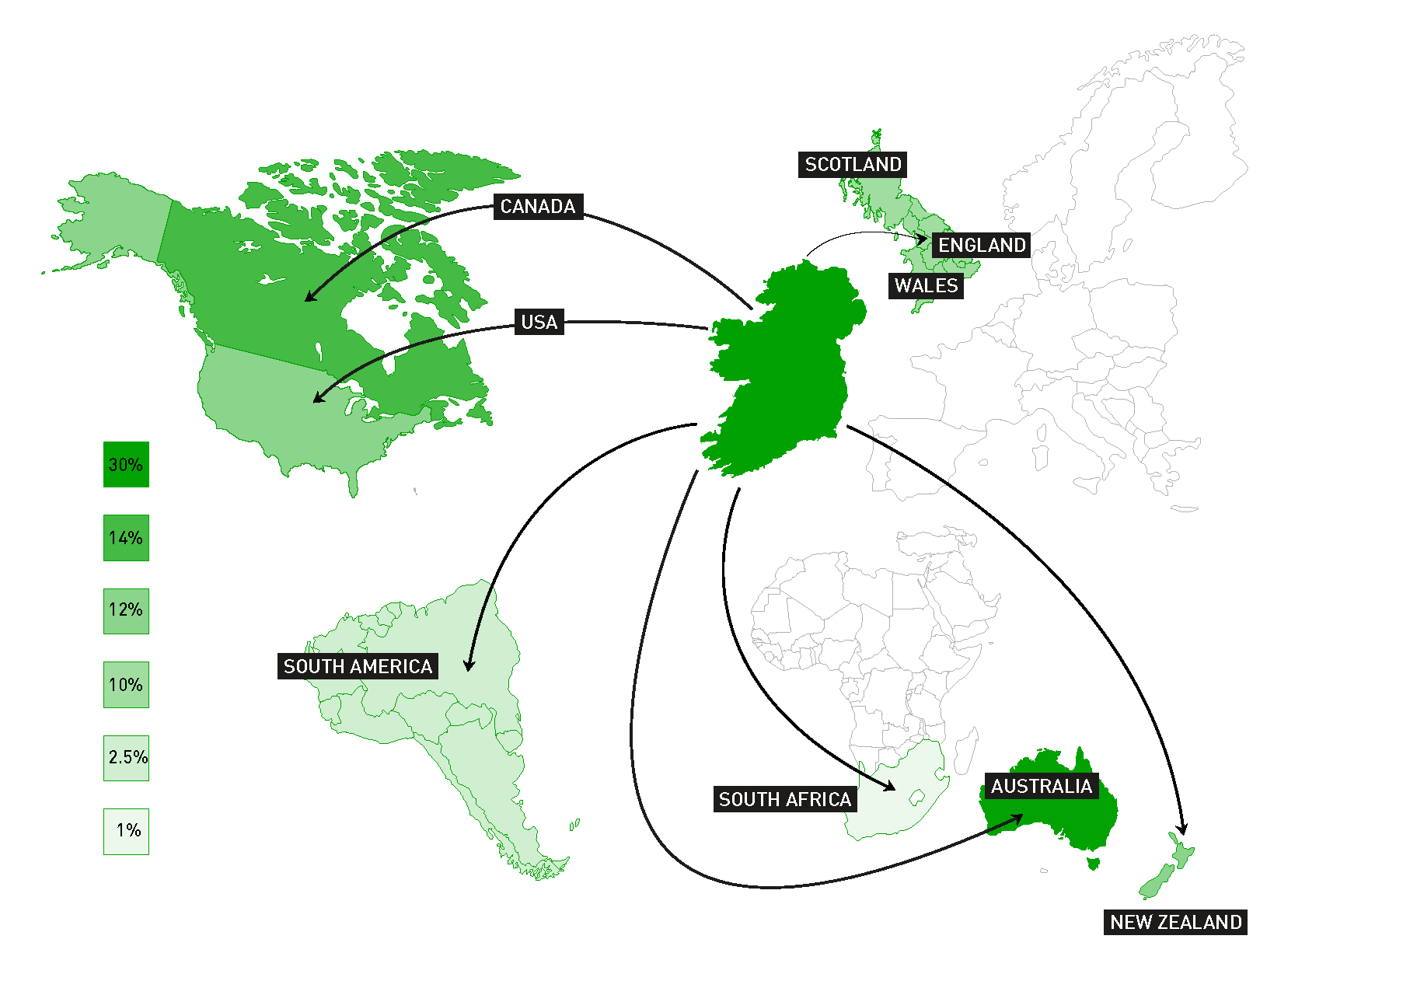
Significance of the Irish Diaspora
Percentage of population of Irish descent

Slide 33
Assessing Your Learning
Fill in the spaces from the box below.
The population of Ireland fell by at least … during the famine.
The … and … … were the worst hit by the famine.
The population decline after the famine was due to … and the low … …
Emigrants went to America, … and …
The Irish Diaspora is the … of the Irish population around the world.
The practice of … the land ended.
Eldest sons ... late.
The Irish language declined in the … and … … of Ireland.
The British government was … for the famine.
emigration south-west Canada subdividing
scattering married blamed Britain
west cottiers two million birth rate
blamed agricultural labourers

Slide 34
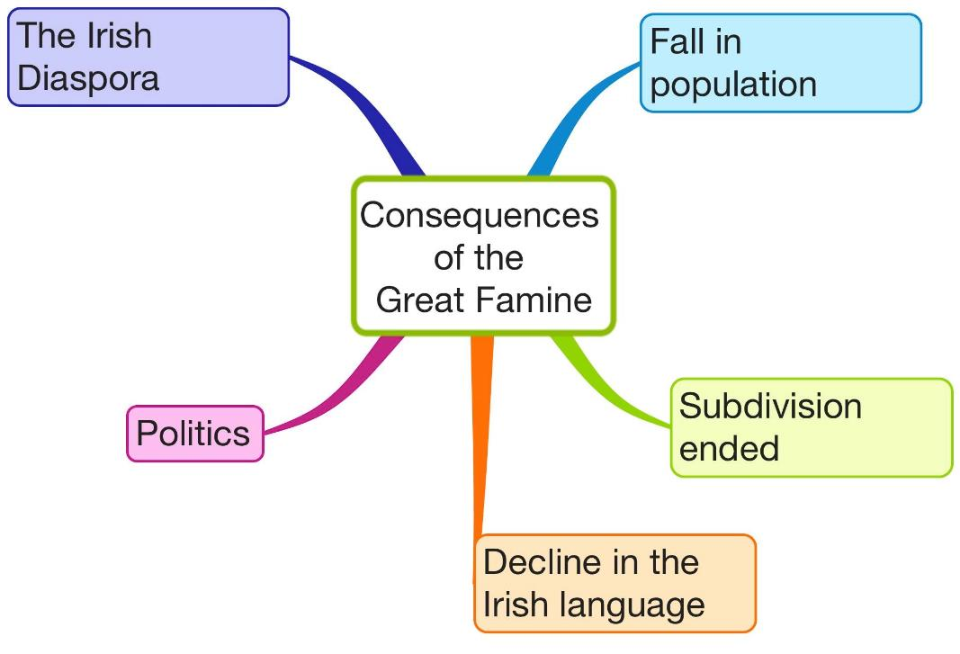
Create your own mind map on the Consequences of the Great Famine based on the above features

Slide 35
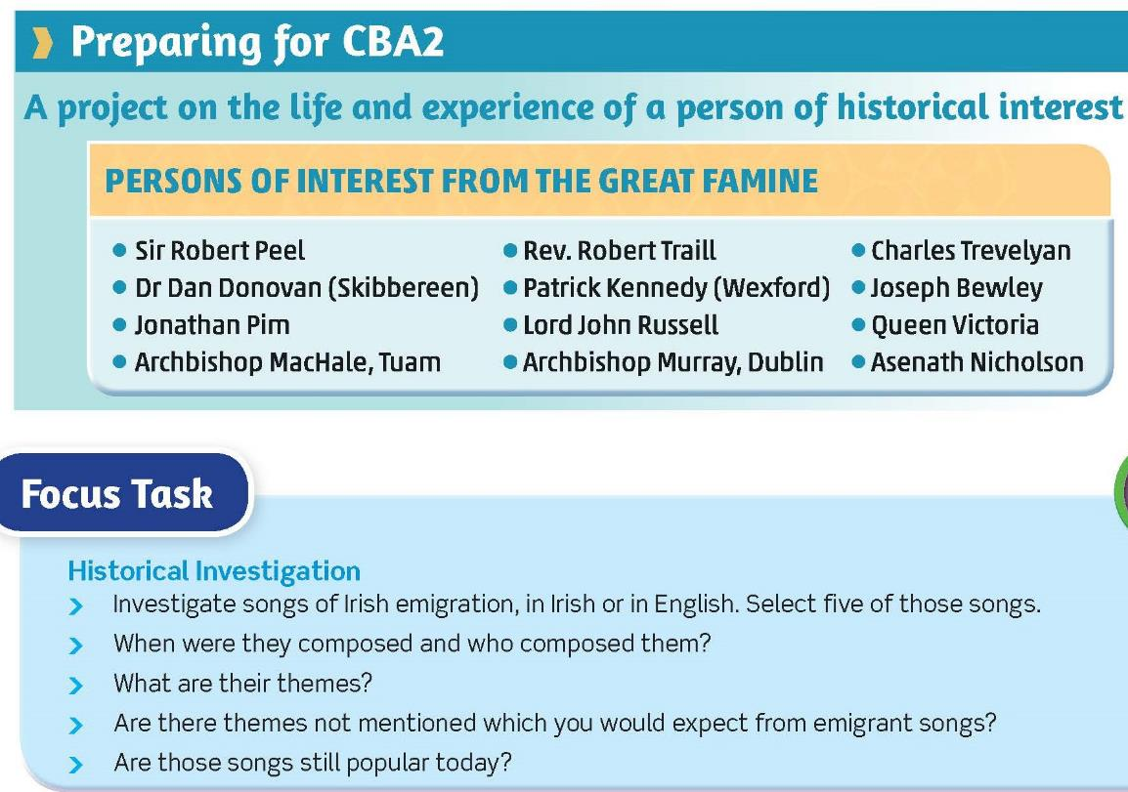
Historical Investigation

Slide 36
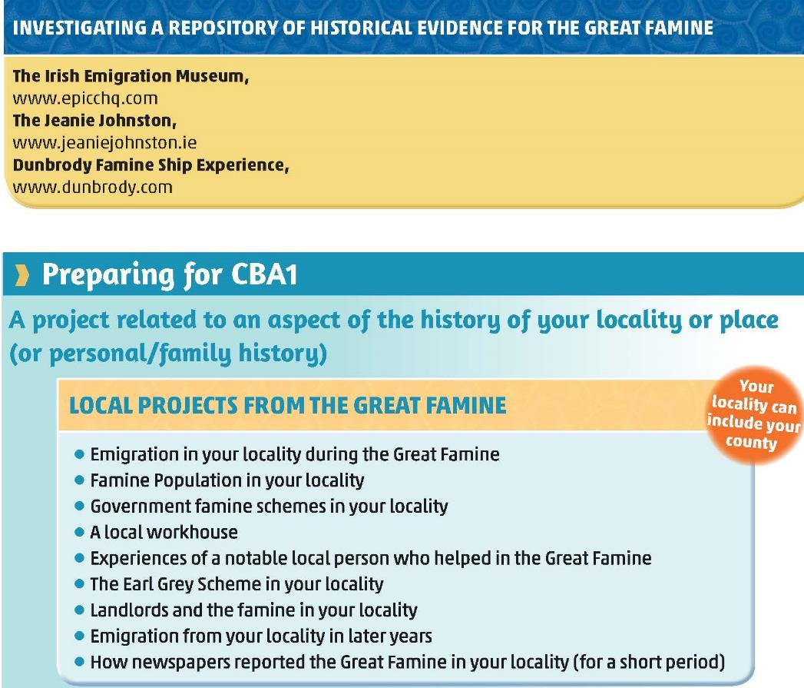
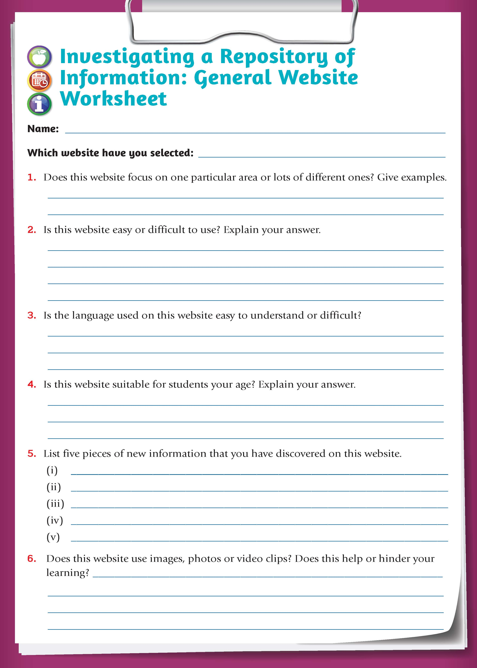
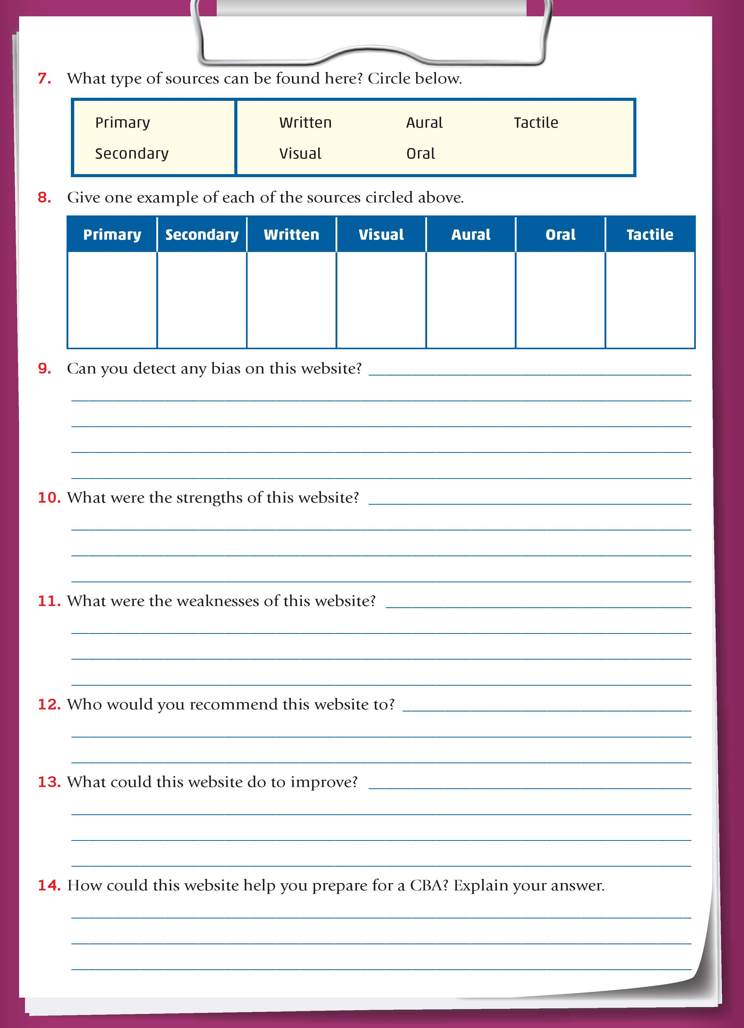

How Do You Rate These Websites?

Slide 37
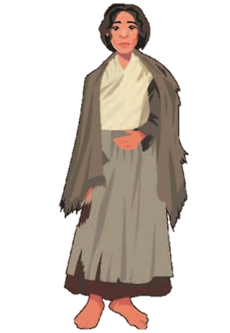
**Note your choices**

Slide 38
**Note your choices**

